Slide 1


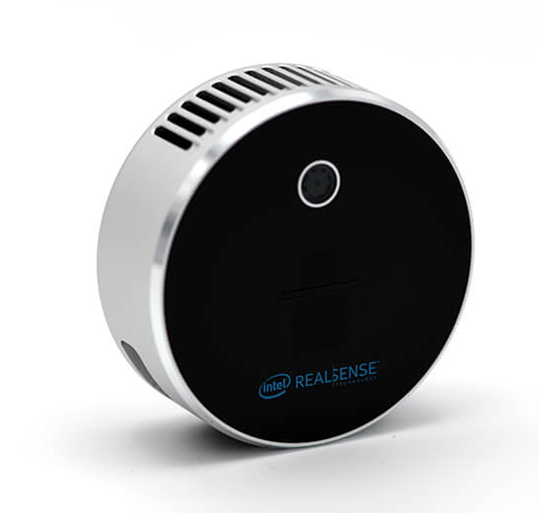
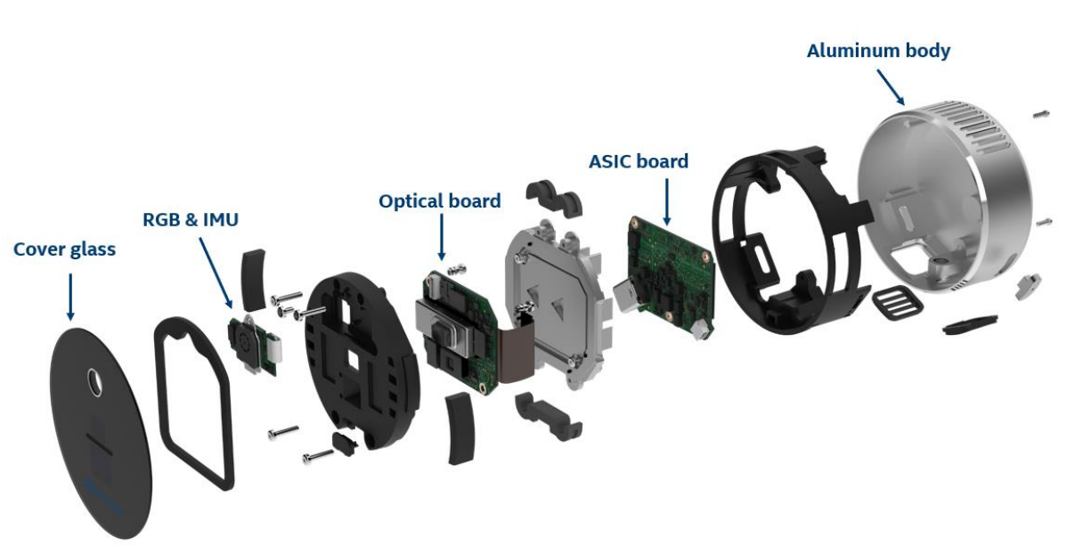
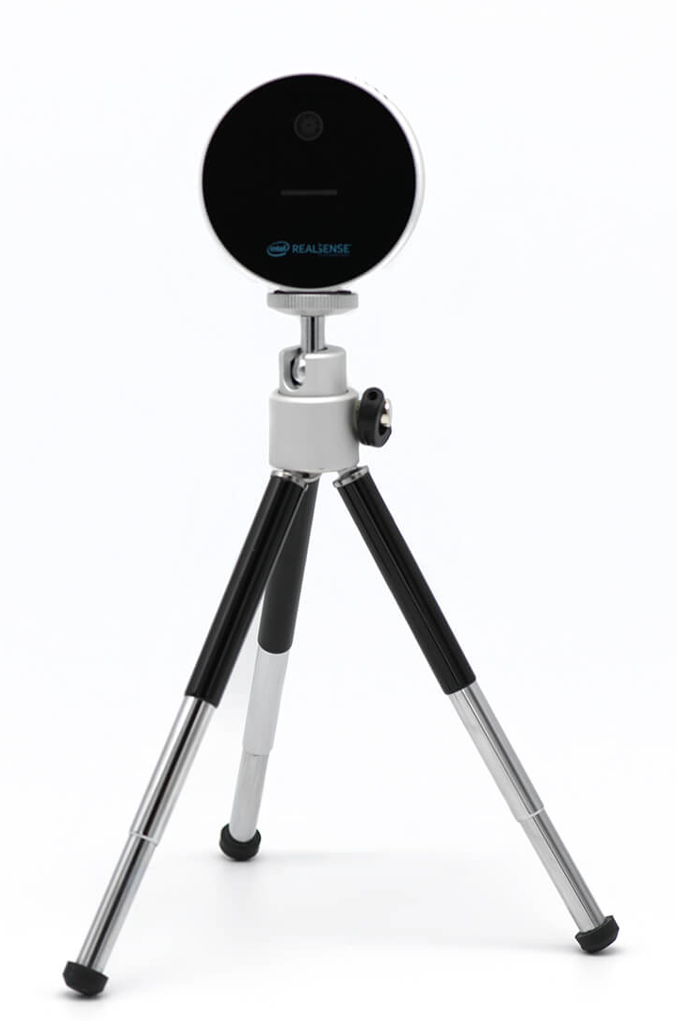

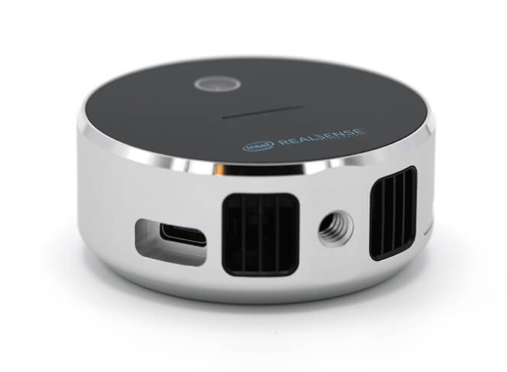
LiDAR INSTRUMENT
Intel® RealSense™ LiDAR Camera L515
Camera Assembly

Slide 2
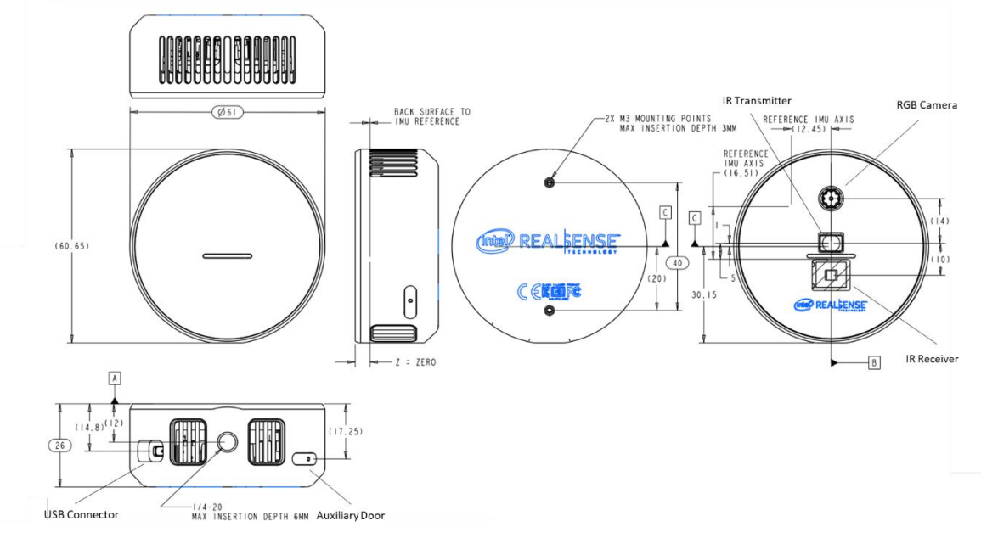
LiDAR INSTRUMENT
Intel® RealSense™ LiDAR Camera L515
Dimensions and Weight
Diameter: 61 mm
Height: 26 mm
Weight: 100 g

Slide 3
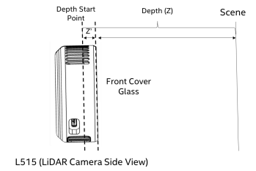
LiDAR INSTRUMENT
Intel® RealSense™ LiDAR Camera L515
Depth Sensing
Range: 0.25 to 9 meters, optimized for indoor use.
Resolution: Up to 1024x768 (XGA) at 30 FPS for depth, capturing over 23 million depth points per second.
The sensor can detect even fast-moving objects with minimal motion blur due to a short exposure time of <100 ns.
Additional Features
RGB Camera: 2MP, with resolutions up to 1920x1080 at 30 FPS.
Power Consumption: Less than 3.5 W.
USB TYPE C 3.1 Gen1 interface
Z’ : - 15 mm

Slide 4
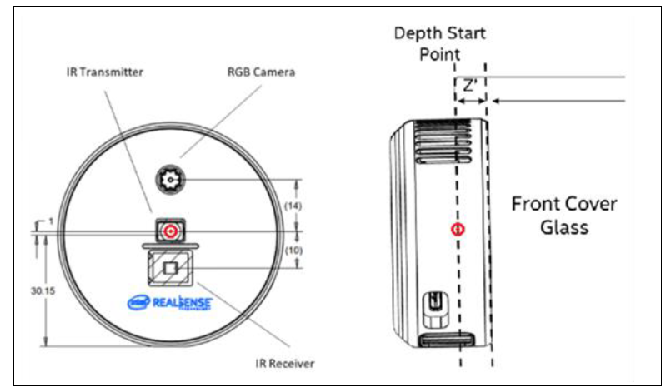
LiDAR INSTRUMENT
Intel® RealSense™ LiDAR Camera L515
Light source
Wavelength
Infrared (IR) laser in the range of 844 nm to 875 nm
Laser Type
Class 1 laser, meaning it is considered safe under normal operating conditions, as it poses no harm to human eyes.
Pulse Duration and Repetition Rate
Pulse duration of 1 nanosecond (ns) contributes to its ability to capture fast-moving objects without significant motion blur.
The repetition rate of the laser is 500 MHz.
Laser Power
The maximum power output is 240 mW

Slide 5





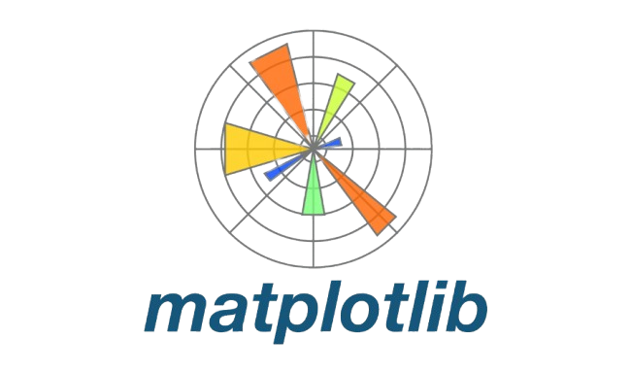
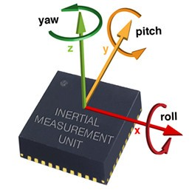
LiDAR INSTRUMENT
Intel® RealSense™ LiDAR Camera L515
Usage and Software
Intel® RealSense™ SDK (librealsense)
Data Processing in Python with pyrealsense2 package
NumPy for numerical operations and array manipulations
OpenCV for image processing tasks such as filtering, segmentation, and visualization.
Point Cloud Library (PCL) for working with 3D point clouds.
Matplotlib for plotting and visualizing data.
Further Processing with Inertial Measurement Unit (IMU)
IMU provides accelerometer and gyroscope data that can be useful for motion tracking or combining depth and motion data in your application.

Slide 6
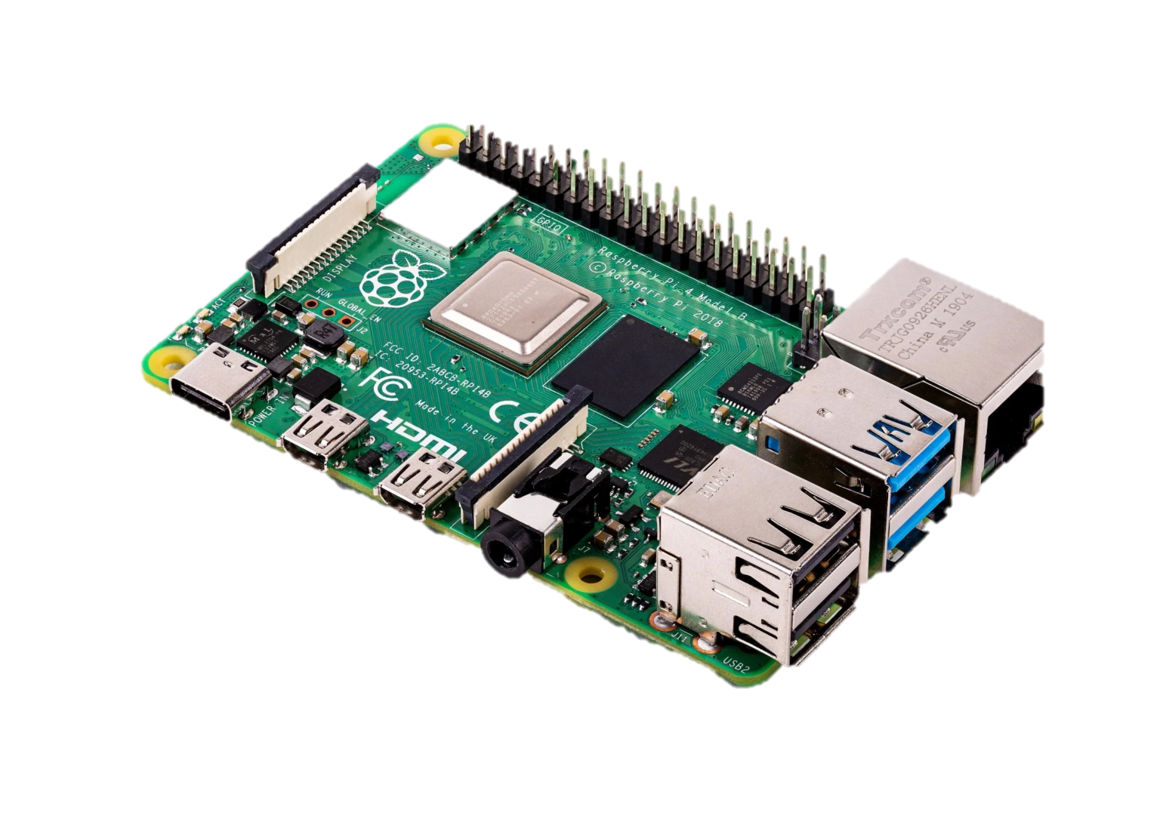
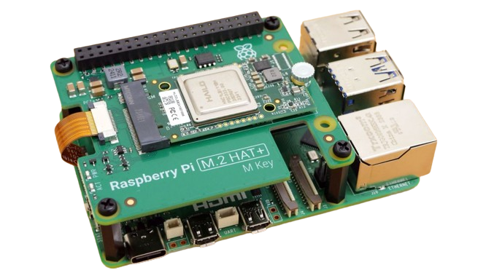
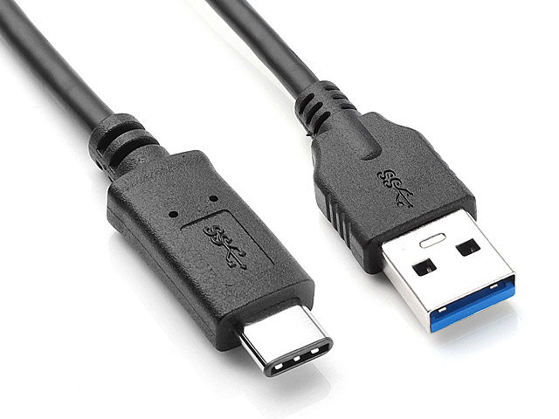
LiDAR INSTRUMENT
Intel® RealSense™ LiDAR Camera L515
Integrating with Raspberry Pi Broad
Raspberry Pi 4 or Raspberry Pi 5 Board
Either the Raspberry Pi 4 or the Raspberry Pi 5 will work, but the Raspberry Pi 5 is recommended due to its better processing power and performance.
The Raspberry Pi 4 will still work, but it may face performance bottlenecks with more complex tasks or higher frame rates.
USB 3.0 Type-C to Type-A Cable
The Raspberry Pi 4 and 5 have USB 3.0 Type-A ports, so we’ll need a USB 3.0 Type-C to Type-A cable for transfer data at high speeds, which is necessary for depth sensing
Raspberry Pi 4
Raspberry Pi 5
USB 3.0 Type-C
to Type-A Cable

Slide 7
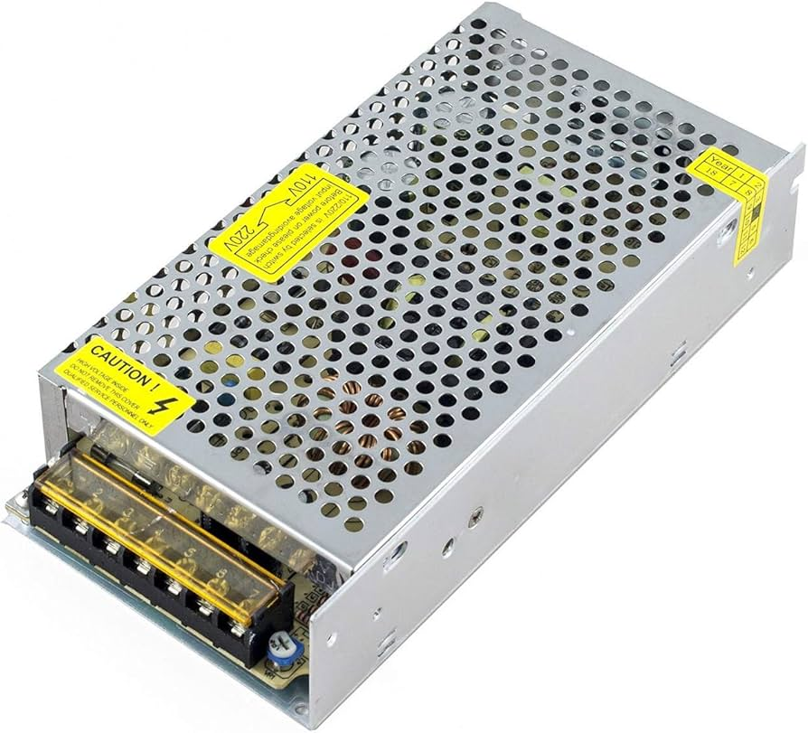
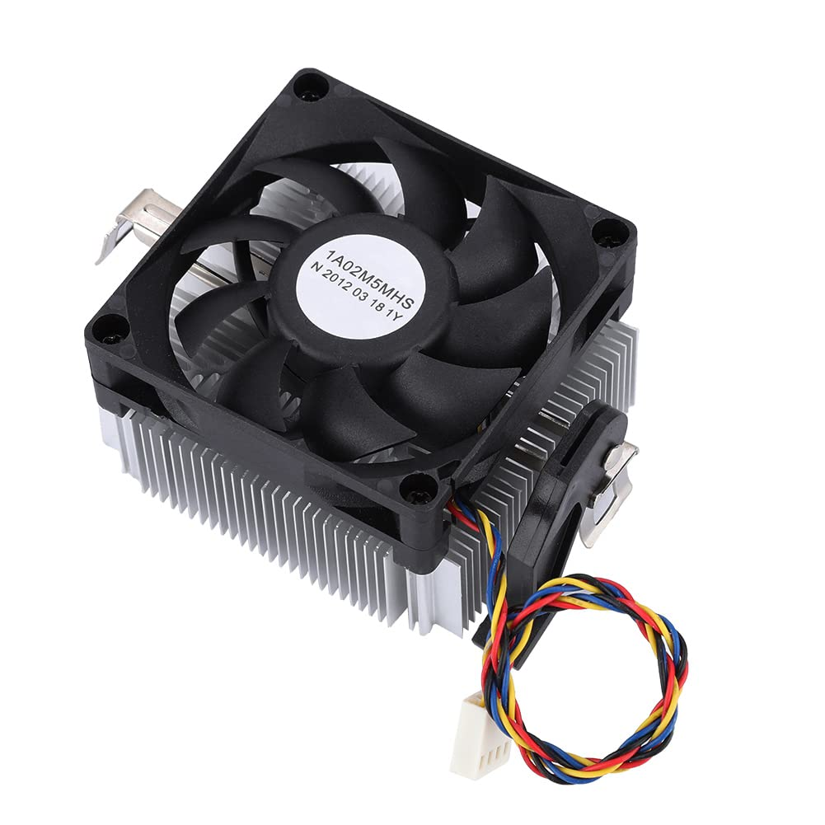
LiDAR INSTRUMENT
Intel® RealSense™ LiDAR Camera L515
Integrating with Raspberry Pi Broad
Power Supply
The Raspberry Pi 4 requires a 5V 3A USB-C power supply
The Raspberry Pi 5 requires a 5V 5A USB-C power supply.
The L515 typically consumes around 3.5W of power during operation, so a stable and sufficient power supply is essential.
Cooling System (Optional but Recommended)
It’s a good idea to use a cooling fan or heat sinks for Raspberry Pi 4 or 5, especially when running tasks that demand high CPU/GPU usage, such as real-time depth data processing or point cloud generation.
Power Supply System
Cooling Fan
Notes:
The Raspberry Pi’s USB 3.0 ports can supply enough power (up to 1.2A per port for peripherals, including the L515), so a dedicated power source for the L515 isn't needed as long as you're using the Pi's recommended 5V, 5A power supply.Avoid using underpowered or low-quality power supplies, as inadequate power can cause performance issues or instability when using both the Raspberry Pi and the L515 simultaneously.

Slide 8
LiDAR INSTRUMENT
Intel® RealSense™ LiDAR Camera L515
Integrating with Raspberry Pi Broad
Cooling Fan
Power Supply 25 W
Cooling System Line
L515
Data Transfer Line
25 W Supply Line
3.5 W Supply Line
Notes:
The Raspberry Pi’s USB 3.0 ports can supply enough power (up to 1.2A per port for peripherals, including the L515), so a dedicated power source for the L515 isn't needed as long as you're using the Pi's recommended 5V, 5A power supply.Avoid using underpowered or low-quality power supplies, as inadequate power can cause performance issues or instability when using both the Raspberry Pi and the L515 simultaneously.

Slide 9
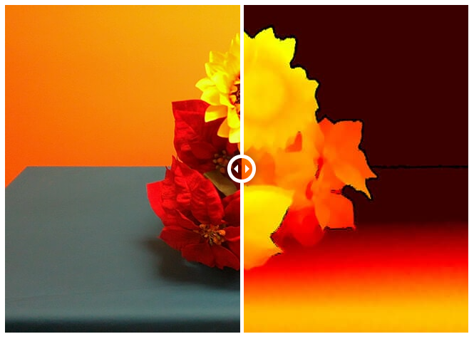
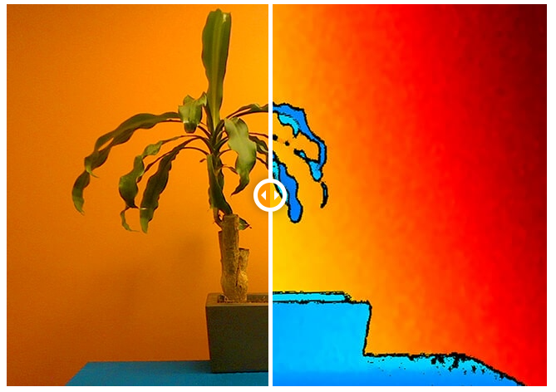
LiDAR INSTRUMENT
Intel® RealSense™ LiDAR Camera L515
Color VS Depth Data
Notes:
The Raspberry Pi’s USB 3.0 ports can supply enough power (up to 1.2A per port for peripherals, including the L515), so a dedicated power source for the L515 isn't needed as long as you're using the Pi's recommended 5V, 5A power supply.Avoid using underpowered or low-quality power supplies, as inadequate power can cause performance issues or instability when using both the Raspberry Pi and the L515 simultaneously.

Slide 10


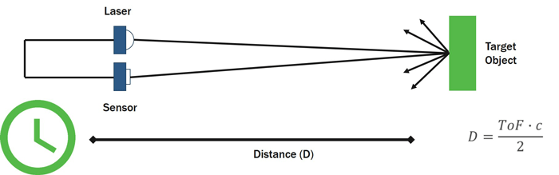
LiDAR
LiDAR Technology: Overview
Overview of LiDAR (Light Detection and Ranging) Technology:
LiDAR operates by emitting laser pulses and measuring the time it takes for the light to return after hitting an object, allowing for the creation of detailed 3D maps.
Feature | LiDAR
Principle of Operation | Emits laser pulses and measures return time to calculate distance.
Accuracy | Highly accurate, capable of generating 3D data
Performance in Low Light | Performs well in low light or total darkness.
Lighting Dependency | Independent of ambient light; works in all lighting conditions.
Multiple returns | LiDAR can "penetrate" certain surfaces
LiDAR Working Principle
https://blog.lidarnews.com/lidar-technology-explained-at-the-electronics-level/
Notes:
"LiDAR, or Light Detection and Ranging, is a technology that operates by emitting laser pulses and measuring the time it takes for the light to return after hitting an object. This principle allows for the creation of highly accurate and detailed 3D maps.
One of the key distinctions between LiDAR and depth cameras is their working principle while the depth camera capture depth information.
In the other hand LiDAR uses laser pulses to directly measure distances, depth cameras typically rely on stereo vision or structured light.
This can make depth cameras out of perform in low-light conditions, where the images used to calculate depth might be unclear or less reliable.
That gives LiDAR a huge advantage in this matter.

Slide 11
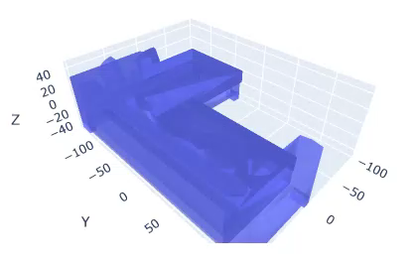
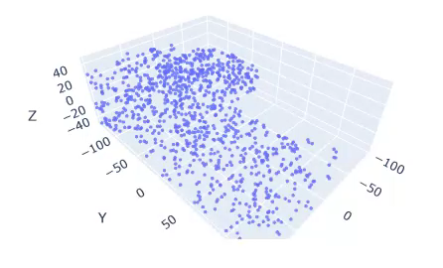
LiDAR
LiDAR Technology: Data Type
LiDAR Data Type:
Pointcloud data
Represents the 3D structure of the environment captured by LiDAR.
Consists of a collection of points, each with X, Y, Z coordinates, representing the surfaces in the 3D space.
Provides detailed spatial information, enabling accurate modeling and analysis of the environment.
Notes:
Let’s delve into the data type which retrieve form LiDAR
The LiDAR generates point cloud data, a collection of data points with X, Y, and Z coordinates representing the 3D structure of an environment.
Each point corresponds to a precise surface location, providing a highly detailed and spatial representation. That’s so magnificent right

Slide 12
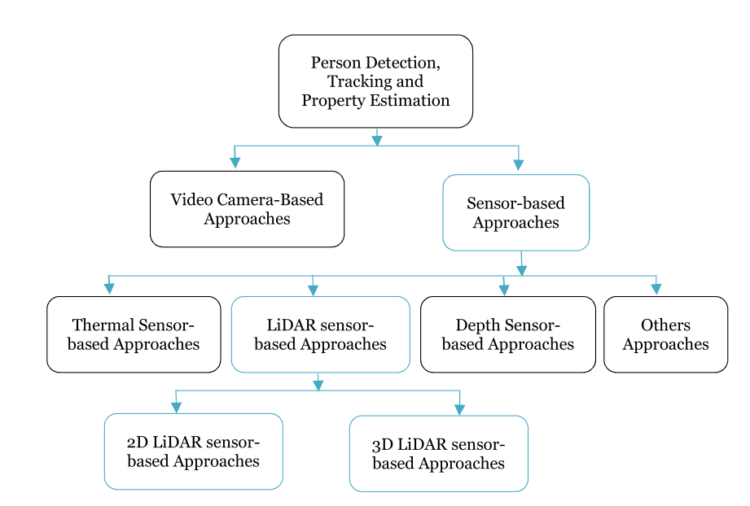
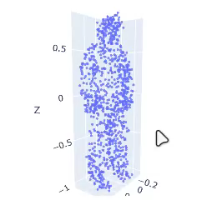
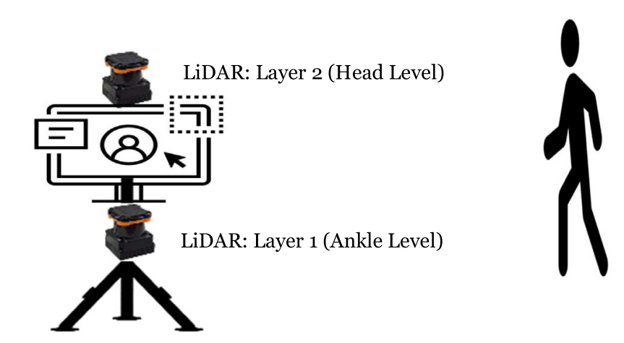
LiDAR
LiDAR Technology: Application
Applications of LiDAR Technology:
Autonomous Vehicles and Robotics.
Environmental Monitoring.
Urban Planning.
LiDAR-Based Detection and Person Tracking:
3D LiDAR Systems
2D LiDAR Systems
 | 2D LiDAR | 3D LiDAR
Dimension | 2, (x,y) axes | 3, (x,y,z) axes
No of Light Beams Emitted | 1 | Multiple
Cost | Less Expensive | Expensive
Response Time | Quick | Slow
3D LiDAR
2D LiDAR
Notes:
LiDAR technology has a wide range of applications today, from autonomous vehicles and robotics to environmental monitoring and urban planning.
And also, in detection and person tracking.
When comparing 2D and 3D LiDAR systems, 3D LiDAR stands out due to its ability to capture depth (X, Y, Z axes) with multiple light beams.
This provides a more comprehensive view of the environment and objects, making it more effective in tracking movement and detecting obstacles.
In vice versa, 2D LiDAR only captures data along two axes (X, Y), which requires the use of two sensors at different heights to gain a full overview of a person’s movement and posture. It’s the same principle as Depth camera

Slide 13
LiDAR
3D Object Processing with LiDAR
Capturing point clouds (sensor data acquisition).
Preprocessing (noise reduction, filtering).
Segmentation (identifying objects or regions of interest).
3D object recognition (classifying and identifying objects in a 3D space).
3D reconstruction (building detailed models from LiDAR data).
Data Processing Workflow
Notes:
LiDAR technology has a wide range of applications today, from autonomous vehicles and robotics to environmental monitoring and urban planning.
And also, in detection and person tracking.
When comparing 2D and 3D LiDAR systems, 3D LiDAR stands out due to its ability to capture depth (X, Y, Z axes) with multiple light beams.
This provides a more comprehensive view of the environment and objects, making it more effective in tracking movement and detecting obstacles.
In vice versa, 2D LiDAR only captures data along two axes (X, Y), which requires the use of two sensors at different heights to gain a full overview of a person’s movement and posture. It’s the same principle as Depth camera

Slide 14
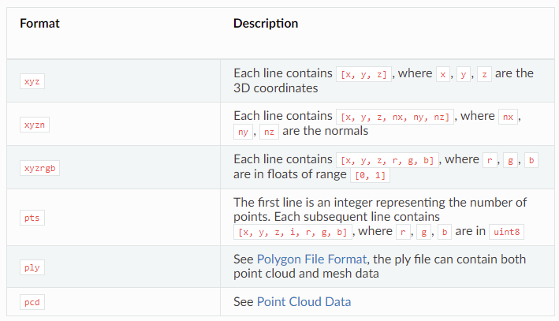
LiDAR
Tools and Libraries
Point Cloud Library (PCL) for processing.
Open3D for visualization and manipulation.
LiDAR-specific algorithms for object detection and classification.
Notes:
LiDAR technology has a wide range of applications today, from autonomous vehicles and robotics to environmental monitoring and urban planning.
And also, in detection and person tracking.
When comparing 2D and 3D LiDAR systems, 3D LiDAR stands out due to its ability to capture depth (X, Y, Z axes) with multiple light beams.
This provides a more comprehensive view of the environment and objects, making it more effective in tracking movement and detecting obstacles.
In vice versa, 2D LiDAR only captures data along two axes (X, Y), which requires the use of two sensors at different heights to gain a full overview of a person’s movement and posture. It’s the same principle as Depth camera

Slide 15
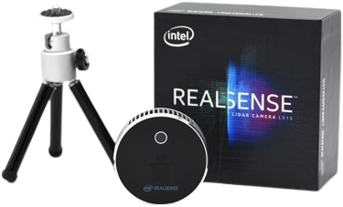
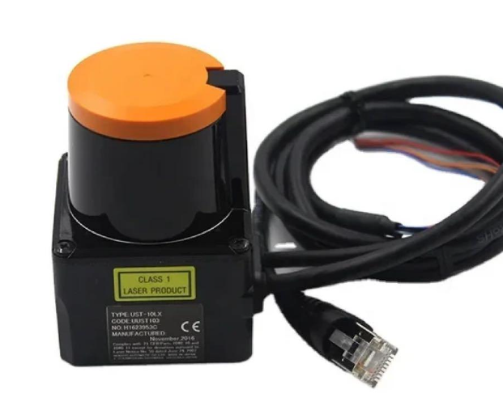
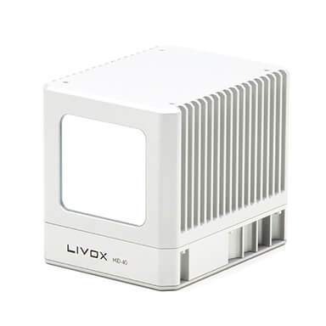
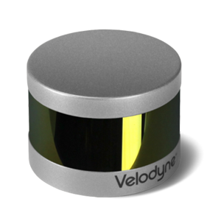
3D LiDAR CAMERA REVIEW
Feature | Intel RealSense L515 | Hokuyo UST-10LX | Livox Mid-40 | Velodyne Puck VLP-16
Depth Resolution | Up to 1024 × 768 | Low resolution | Up to 100,000 points/second | Up to 300,000 points/second
Range | 0.25 m to 9 m | Up to 10 m | 0.2 m to 260 m | 0.5 m to 100 m
Field of View | 70° (H), 55° (V) | 270° | 38.4° | 360°
Lighting Conditions | Works in all lighting conditions | Limited by lighting | Works in all lighting conditions | Works in all lighting conditions
Accuracy | ±5 mm at 2.5 m | ±30 mm at 10 m | ±2 cm | ±3 cm
Cost (YEN) | ¥118,800 | ¥164,000 | ¥78,000 | ¥250,000
Raspberry Pi Compatibility | Compatible with additional processing power | May require additional adapters | Compatible with proper integration | Compatible with additional processing power

